Slide 1
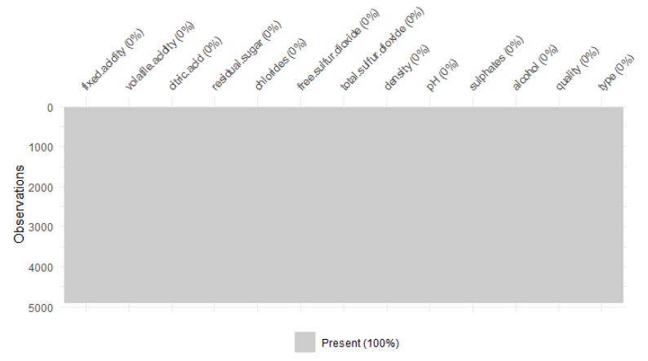
Figure 1. No missing data in the dataset

Slide 2
Table 1. Summarize the variables of Data Set
Variable Name | Min | 1st.Q | Median | 3rd.Q | Max | Mean | SD
Fixed.acidity | 3.80 | 6.30 | 6.80 | 7.30 | 14.20 | 6.86 | 0.844
Volatile.acidity | 0.08 | 0.21 | .026 | 0.32 | 1.10 | 0.28 | 0.101
Citric.acid | 0.00 | 0.27 | 0.32 | 0.39 | 1.66 | 0.33 | 0.121
Residual.sugar | 0.60 | 1.70 | 5.20 | 9.90 | 65.80 | 6.29 | 5.072
Chlorides | 0.01 | 0.04 | 0.04 | 0.050 | 0.35 | 0.05 | 0.022
Free.sulfur.dioxide | 2.00 | 23.00 | 34.00 | 46.00 | 289.00 | 35.31 | 17.01
Total.sulfur.dioxide | 9.00 | 108.00 | 134.00 | 167.00 | 440.00 | 138.40 | 42.50
Density | 0.99 | 0.99 | 0.99 | 1.00 | 1.04 | 0.99 | 0.003
PH | 2.72 | 3.09 | 3.18 | 3.28 | 3.82 | 3.19 | 0.151
Sulphates | 0.22 | 0.41 | 0.47 | 0.55 | 1.08 | 0.49 | 0.114
Alcohol | 8.00 | 9.50 | 10.40 | 11.40 | 14.20 | 10.51 | 1.231

Slide 3
Table 2. Quantity of wines by quality of scores.
Scores | 3 | 4 | 5 | 6 | 7 | 8 | 9
Quantity | 20 | 163 | 1457 | 2198 | 880 | 175 | 5

Slide 4
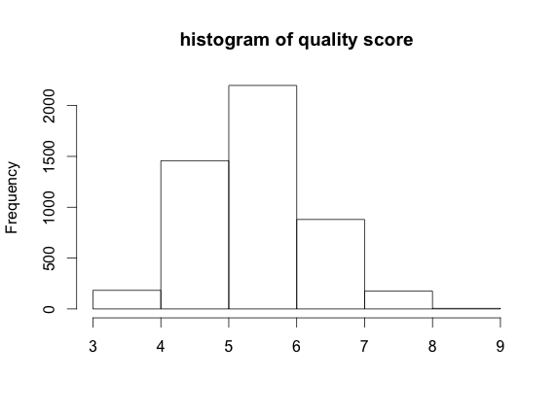
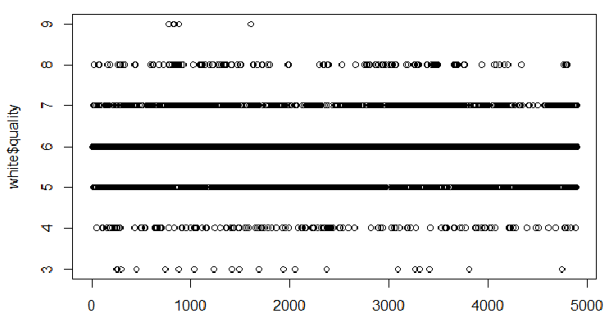
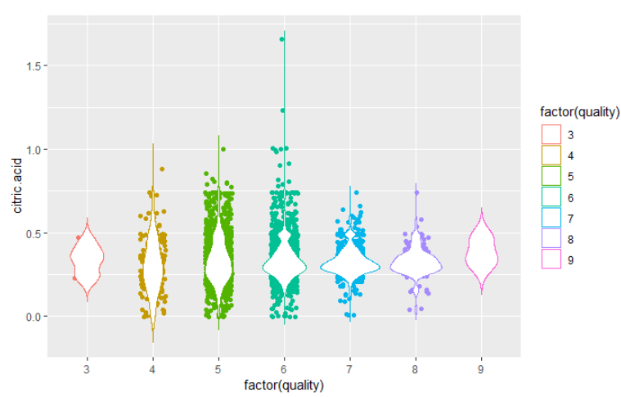
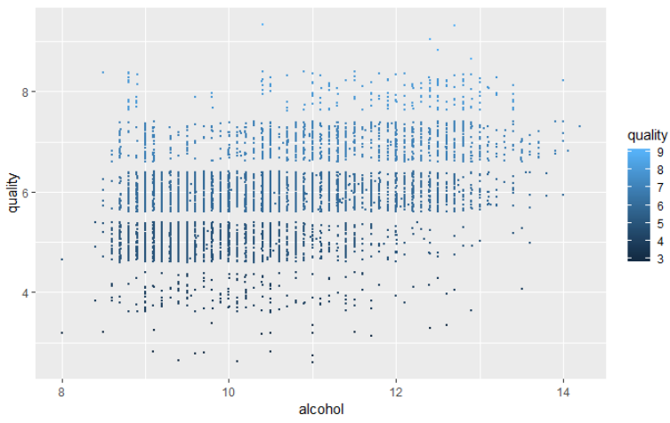
Figure 2. Uneven distribution of observers by quality scores
Scatter plot
Violin plot

Slide 5
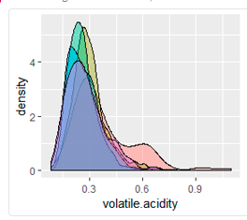
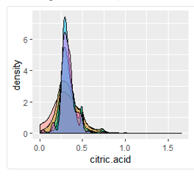
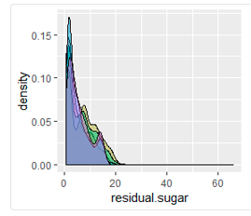
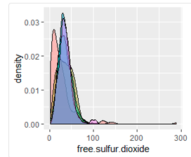
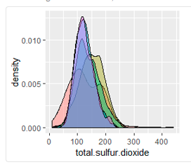
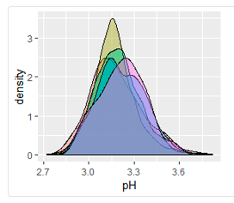
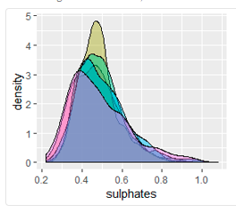
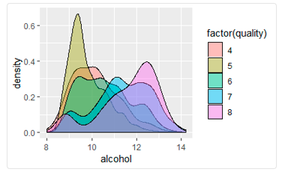
Figure 3. Density plots of variable by scores of quality

Slide 6
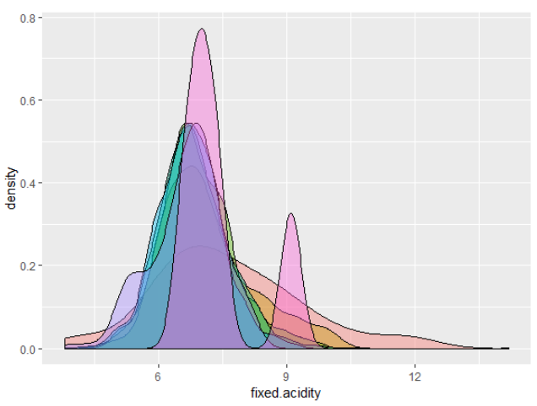
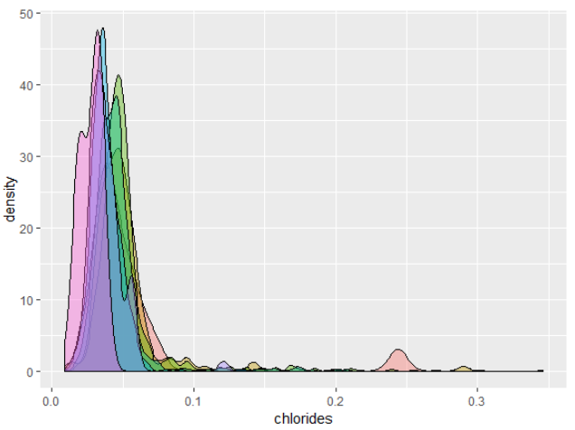
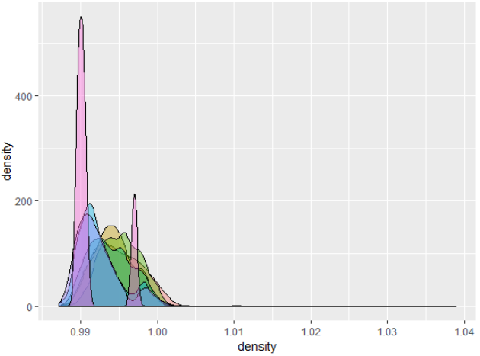
Figure 1. Continue

Slide 7
Tabel 3. means of different variable by score of wine quality
variables | 4 | 5 | 6 | 7 | 8
fixed.acidity | 7.18 | 6.93 | 6.83 | 6.73 | 6.67
volatile.acidity | 0.37 | 0.30 | 0.26 | 0.26 | 0.27
citric.acid | 0.30 | 0.33 | 0.33 | 0.32 | 0.32
residual.sugar | 4.82 | 7.33 | 6.44 | 5.18 | 5.62
chlorides | 0.05 | 0.05 | 0.04 | 0.03 | 0.03
free.sulfur.dioxide | 26.63 | 36.43 | 35.65 | 34.12 | 36.62
total.sulfur.dioxide | 130.23 | 150.90 | 137.04 | 125.1 | 125.88
density | 0.99 | 0.99 | 0.99 | 0.99 | 0.99
pH | 3.18 | 3.16 | 3.18 | 3.21 | 3.21
sulphates | 0.47 | 0.48 | 0.49 | 0.50 | 0.48
alcohol | 10.17 | 9.80 | 10.57 | 11.36 | 11.65

Slide 8
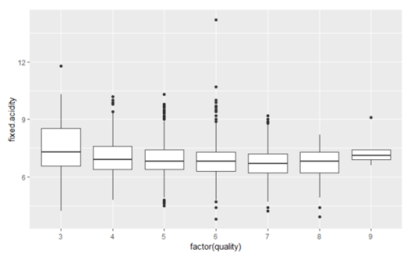
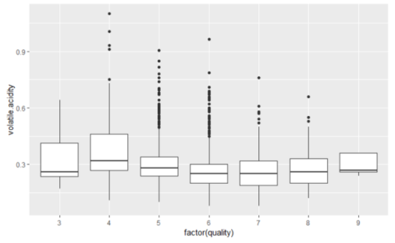
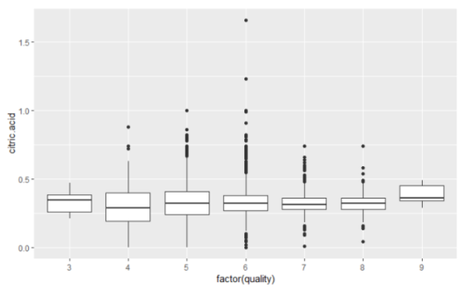
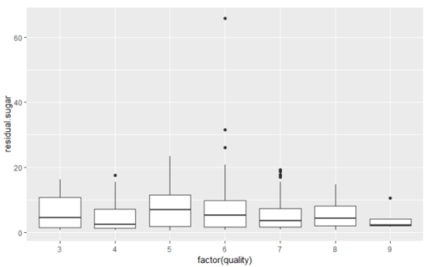
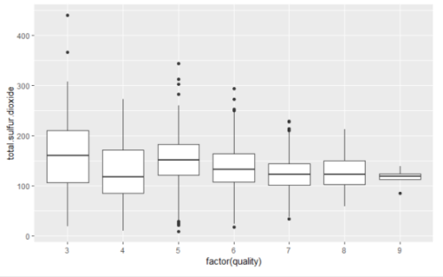
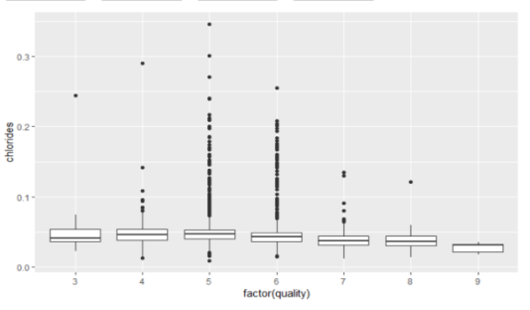
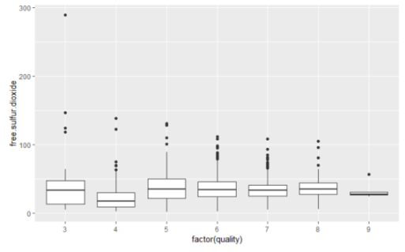
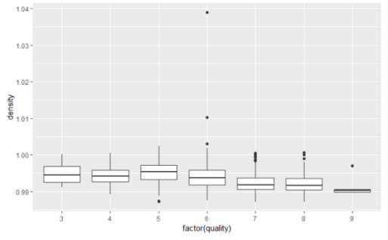
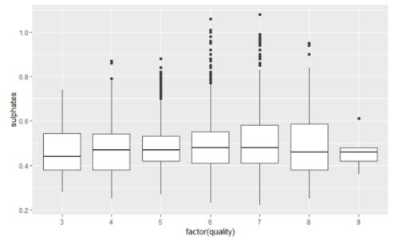
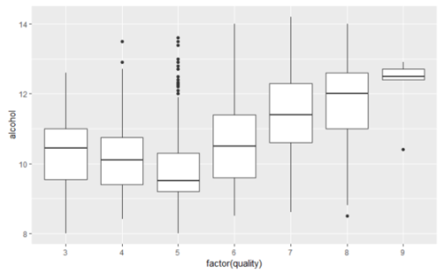
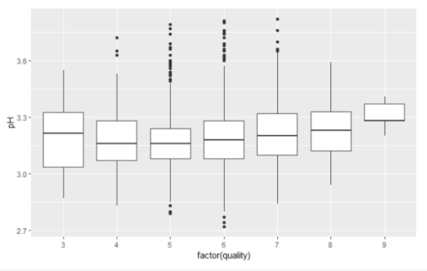
Figure 4. Boxplot of variables by score of quality

Slide 9
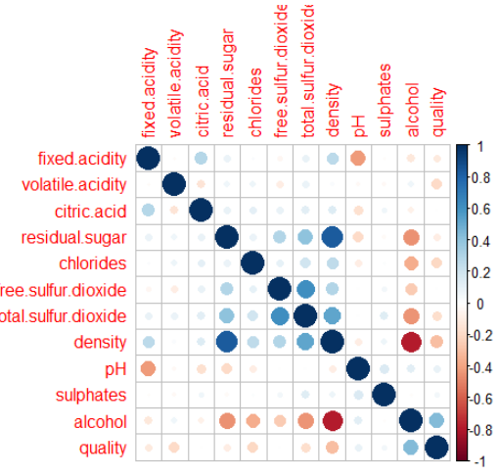
Figure 5. Correlations between variables

Slide 10
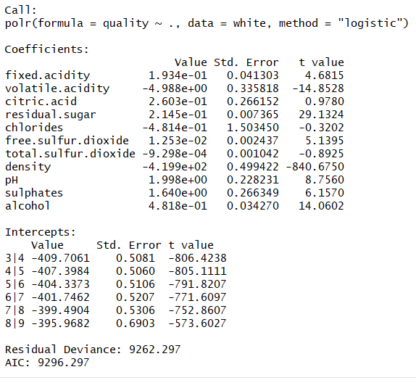
Figure 6. Summary of analysis of ordinal logistic regression model with all variables

Slide 11
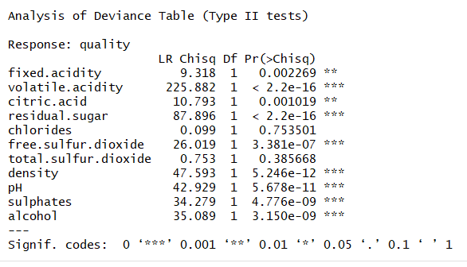
Figure 7. Comparing association of variables with quality

Slide 12
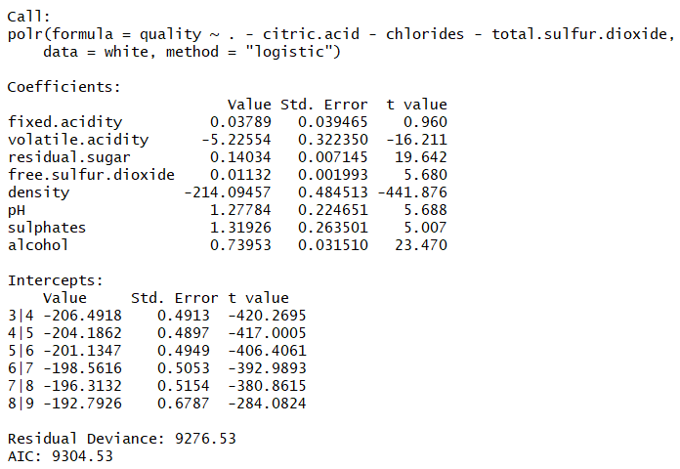
Figure 8. Slightly increase of residual deviance and AIC values in significant variale model.

Slide 13
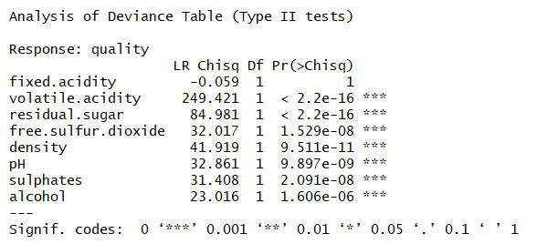
Figure 9. Significant association with quality scores

Slide 14
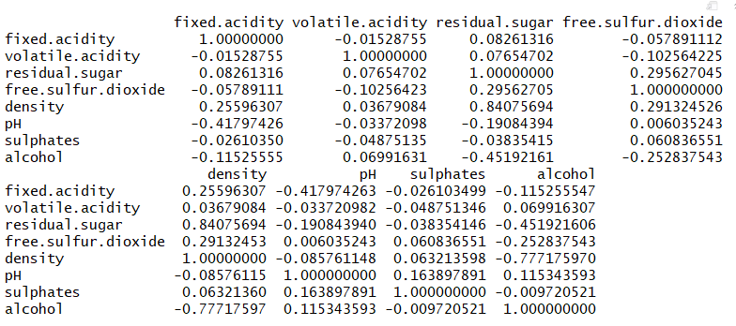
Figure 10. Correlation matrix of wine quality data

Slide 15
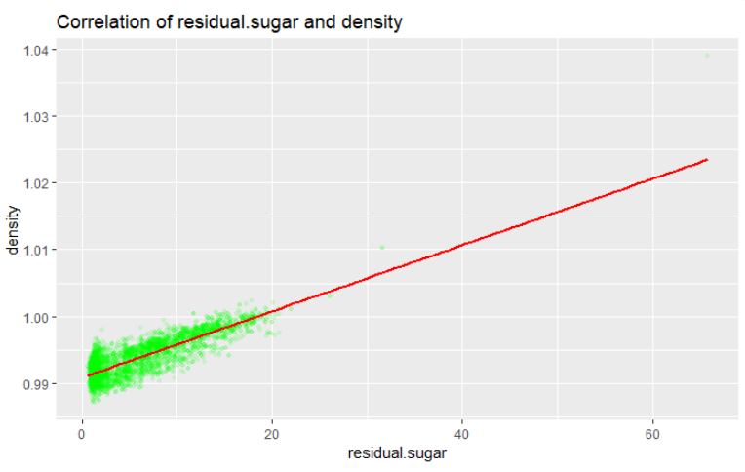
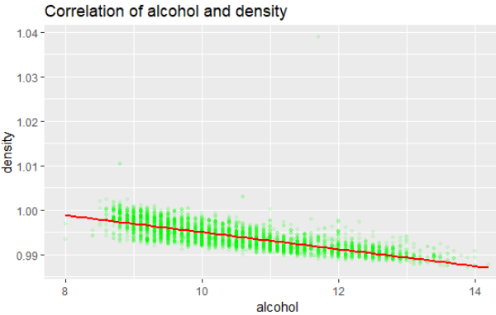
Figure 11. Scatter plot showing correlations between density and residual.sugar/alcohol

Slide 16
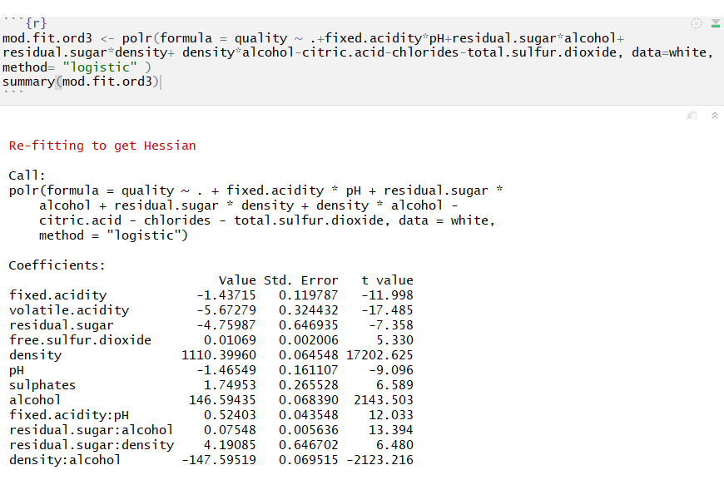
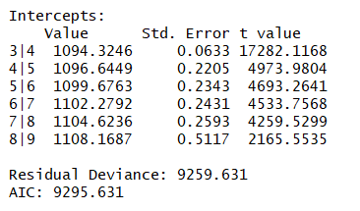
Figure 12. Adjustification colinearity of ordinal logistic model

Slide 17
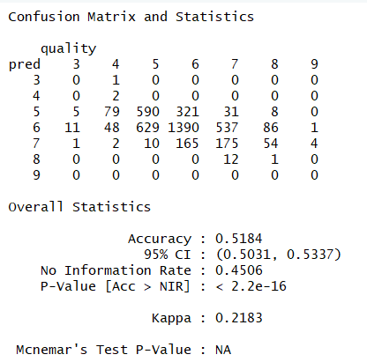
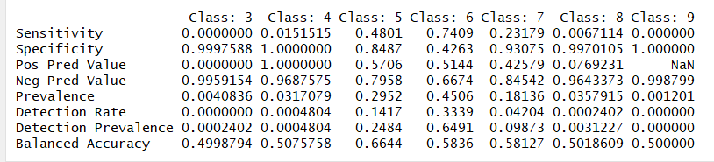
Figure 13. Confusion Matrix of Model 3

Slide 18
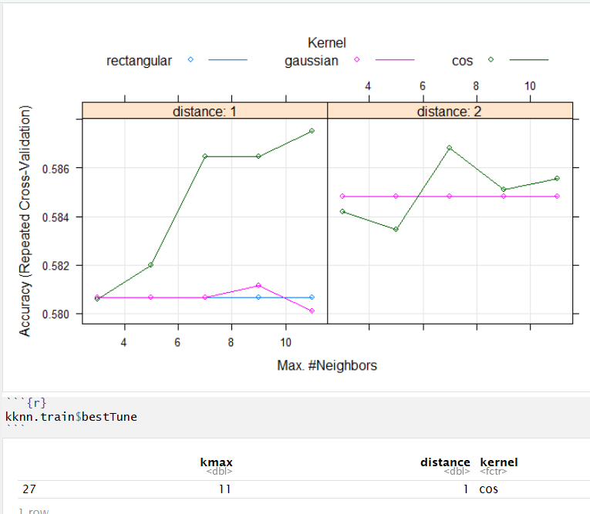
Figure 14. knn full model

Slide 19
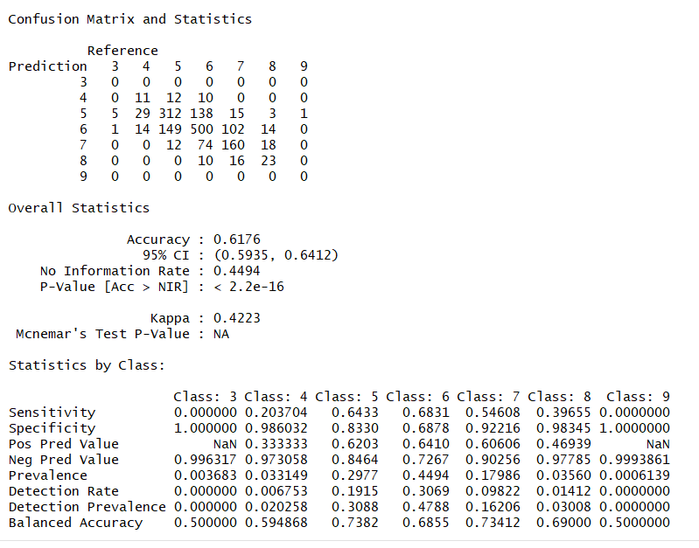
Figure 15. Confusion matrix and statistics of k-NN full model

Slide 20
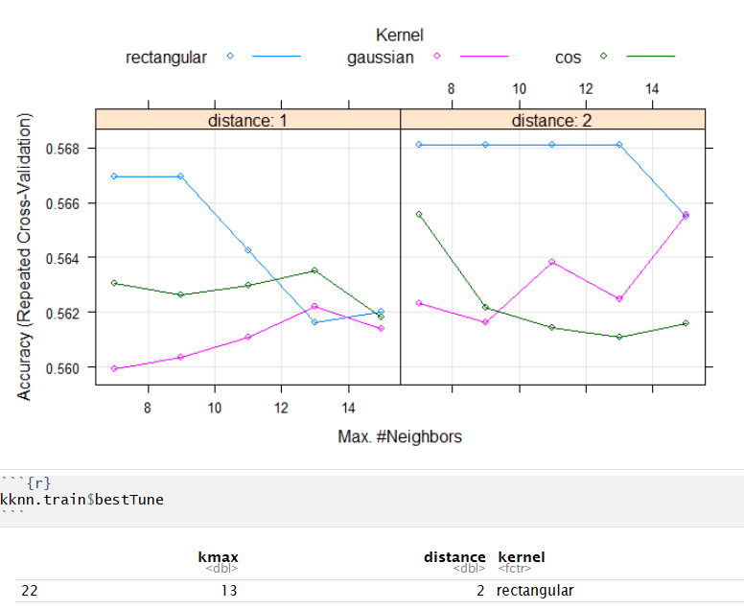
Figure 16. knn reduced model

Slide 21
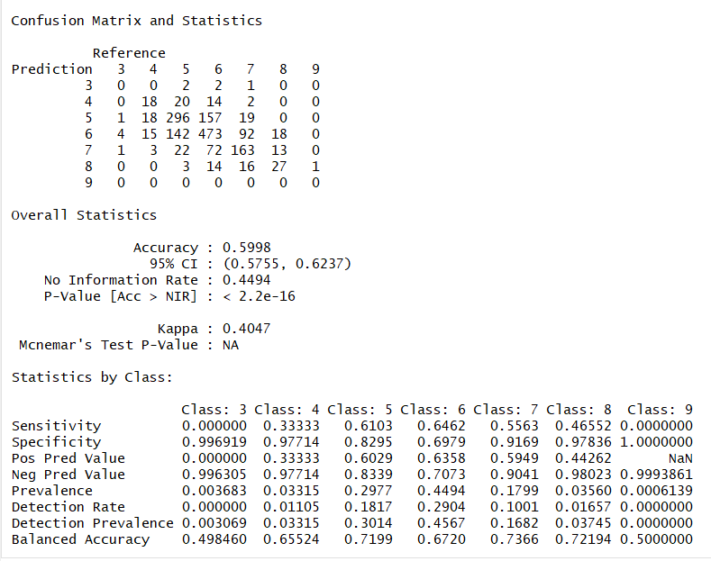
Figure 17. Confusion matrix and statistics of k-NN reduced model

Slide 22
Table 18A. Compare major parameters of different models
 | KNN full model | KNN reduced | Ordered log. Full
Accuracy | 0.62 | 0.60 | 0.53
95% CI | 0.59-0.64 | 0.58-0.62 | 0.50-0.55
P Value | <2.2e-16 | <2.2e-16 | <3.86e-9
Kappa value | 0.42 | 0.40 | 0.23

Slide 23
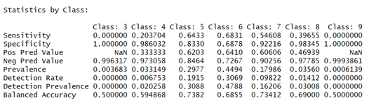
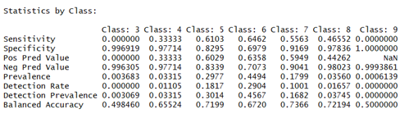
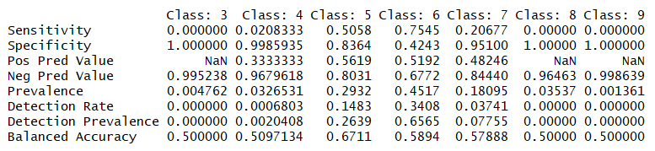
Table 18B. Compare statistics by classes in different models
KNN Full Model
KNN Reduced Model
Ordered
Logistic
Regression

Slide 24
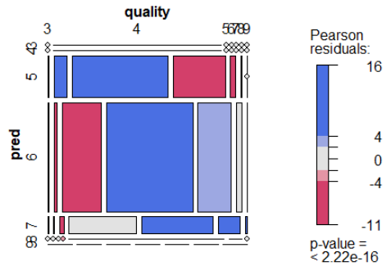
Figure 19. Mosaic plot of model 3

